Slide 1



Graphics and Computational Programming
By Maria Tozo

Slide 2
Project Information
For this project I choose to do a parallel ray tracer. With the completed project being able to render some simple shapes with a choice of different material for each shape that would interact with multiple lights.
Throughout this video I will go over and discuss my research into ray tracing and parallelisation and how it helped me in design and implement my ray tracer

Slide 3

The Theory

Slide 4

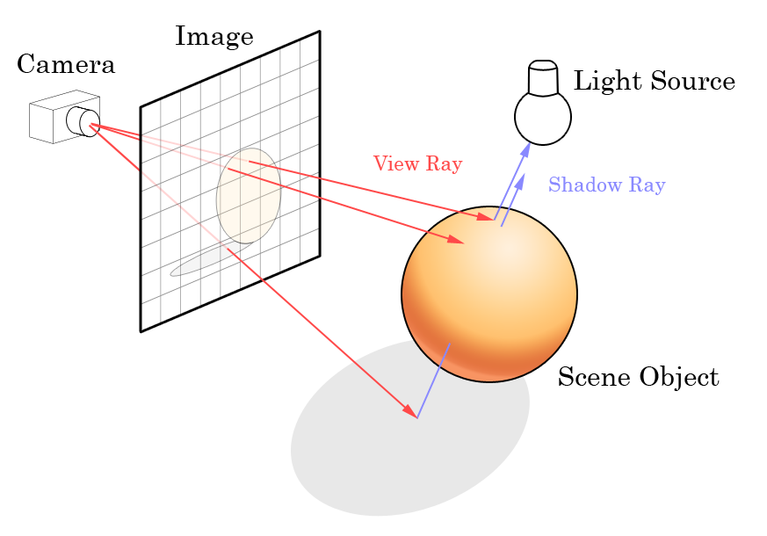
What is Ray Tracing?
Ray Tracing is the process of rendering a 3D images on a 2D display by tracing a path of light through pixels on an image plane.
Ray tracing is done by sending a ray that represents a pixel from your camera point into the scene that checks for a collision with any scene objects and return its color.
Though it’s capable of producing a much higher degree of realism over other rendering methods, it comes a much greater computational cost and can take a while to render an image.
Figure by Unknown Author is licensed under CC BY-SA

Slide 5
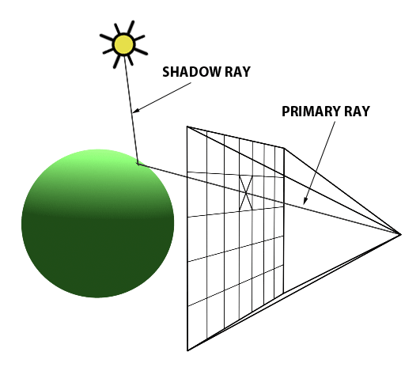
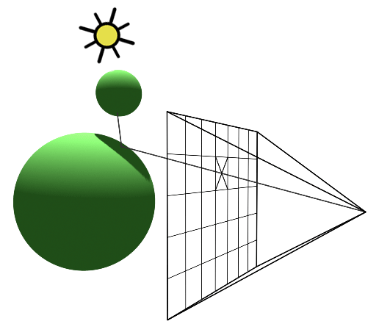
Shadows
Shadows easily done in raytracing and often only need a handful of lines to implement.
The basic method of checking for shadows is that after a ray has collided with an object send another ray from said point to your light source.
If the ray collides with any of the objects in the scene then the point your checking is in shadow.
Figure by Scratch a Pixel

Slide 6
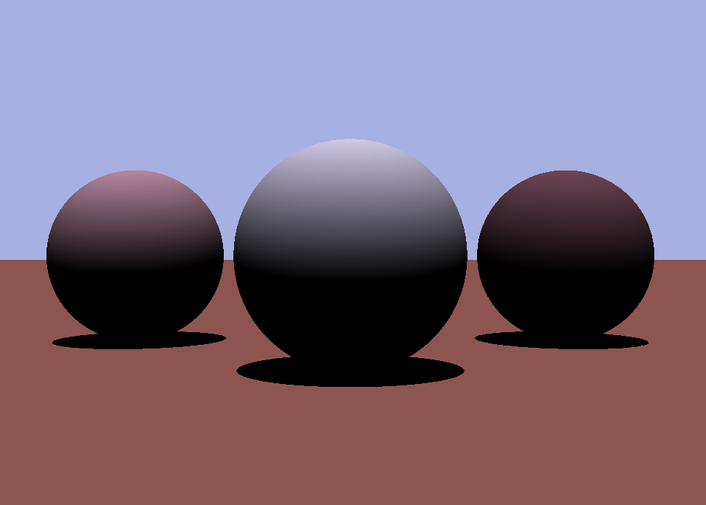
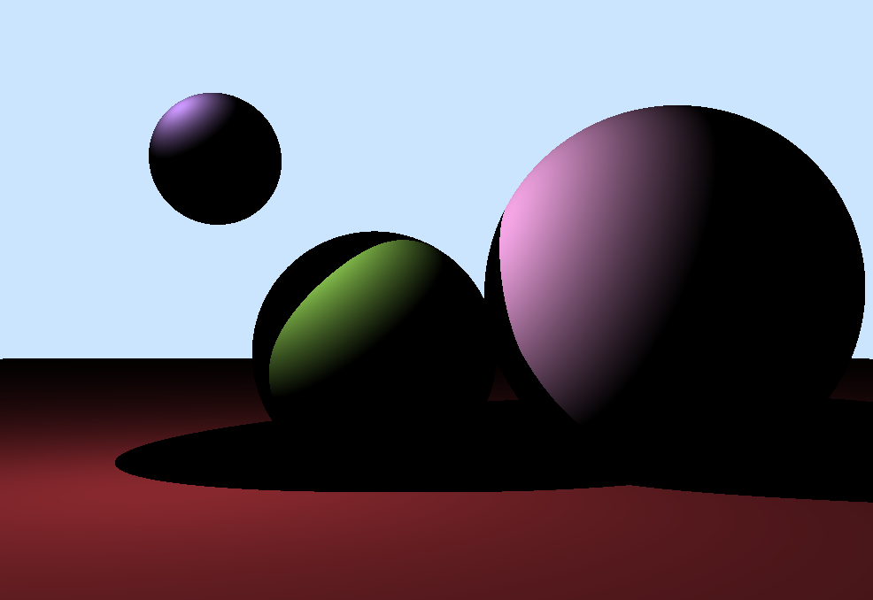
My Examples

Slide 7
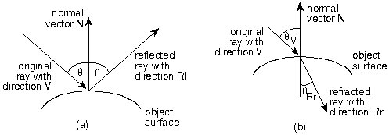
Reflections
Like shadows reflections are done by simply by sending another ray from your hit point into the scene.
If the object we've collided with is reflective then another ray is sent out from that point with a new direction.
“NewDirection = V + (2 * N * – Dot_Product(N, V))” (Rademacher, 2020)
And like with shadows we check if it intersecs with anything in the scene an if it does, we return said colitions color
Figure by Paul Rademacher

Slide 8
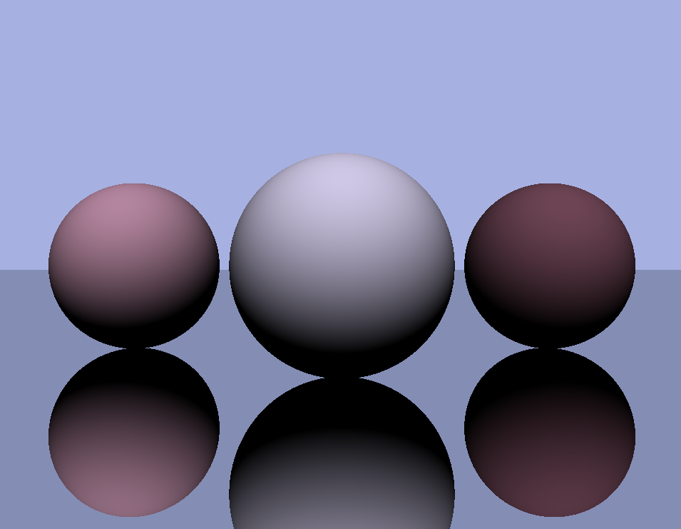
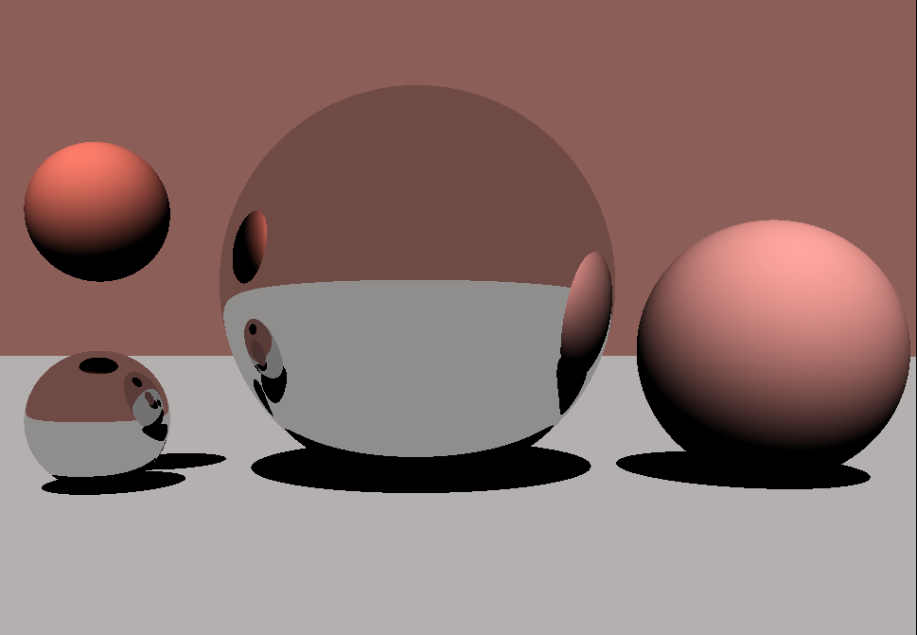
My Examples

Slide 9


What is parallel programming?
Parallel programming is a type of computation in which many processes or the execution of processes are carried out simultaneously.
There are several ways to make a program parallel, but most mainly center around breaking a large task into smaller tasks and running them in parallel.
Though it can be tricky to understand and first and test it increase the efficiency and resources of a program and gain the ability to achieve results much quicker.
Figure by Paul Rademacher
Figure by Paul Rademacher

Slide 10
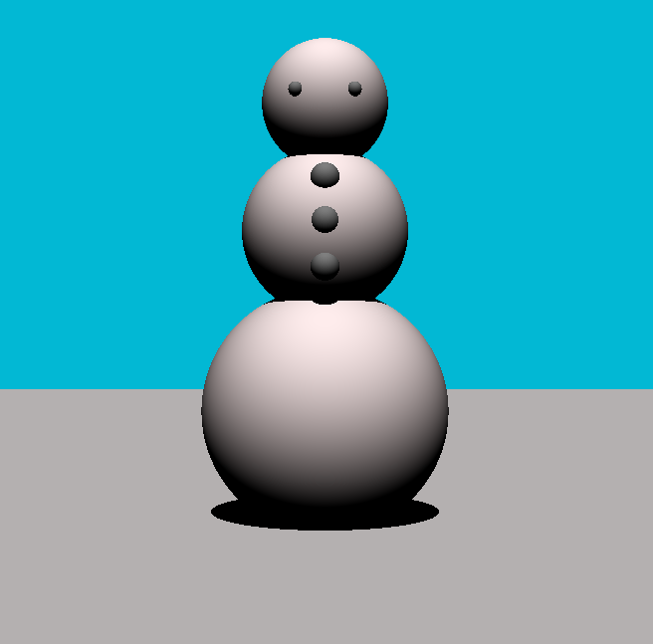
Ray Tracing & parallelisation
Ray tracing lends itself nicely to parallelisation as each pixel can be easily be rendered in parallel.
This can make significant cuts to the rendering time that ray tracing on the GPU is known for. The way I have decided to do this is by using multi-threading.
With a pool of threads that get given the task to render a part of the screen, then when all rays are done for it to display onto the screen as one image.

Slide 11

Experiments

Slide 12
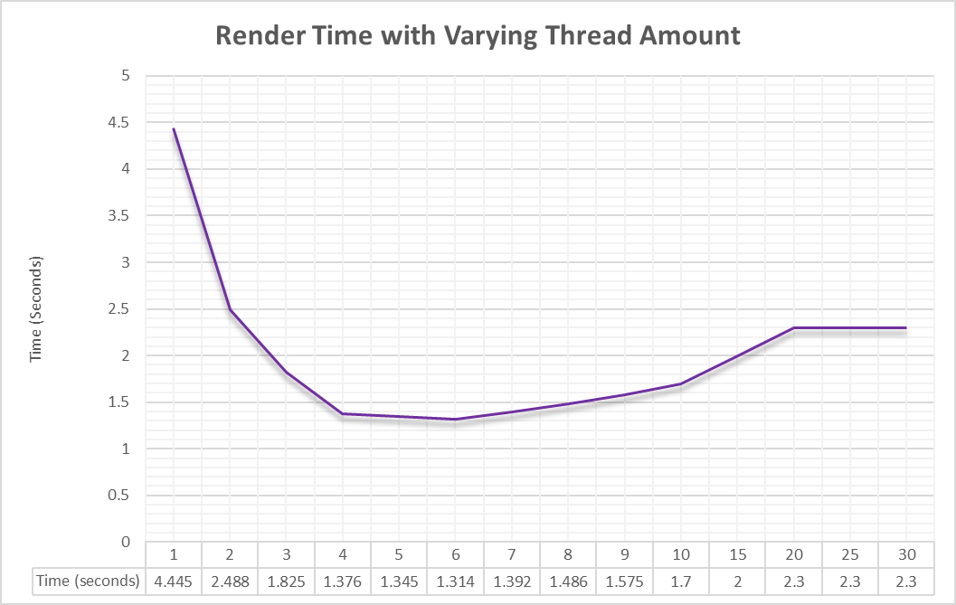
Experiments
On the graph you can the time is takes to render a scene with a single object in debug mode.
The time goes from almost 4.5 seconds to 1.5 seconds with the addition of more threads. But doesn't fall much further.

Slide 13
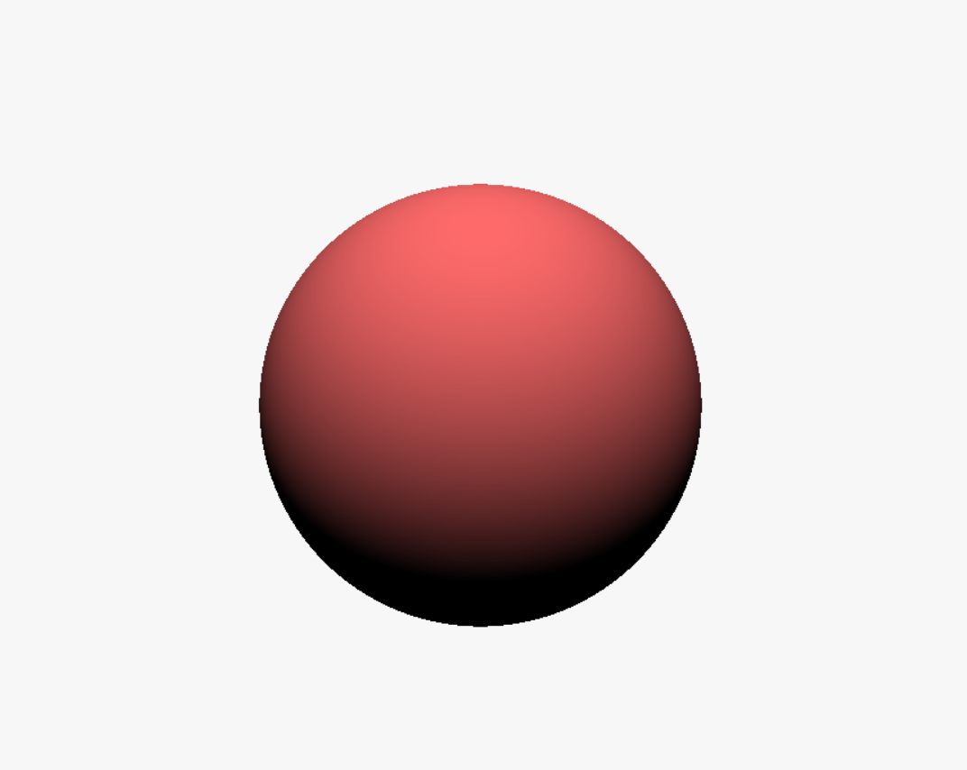
The Scene

Slide 14
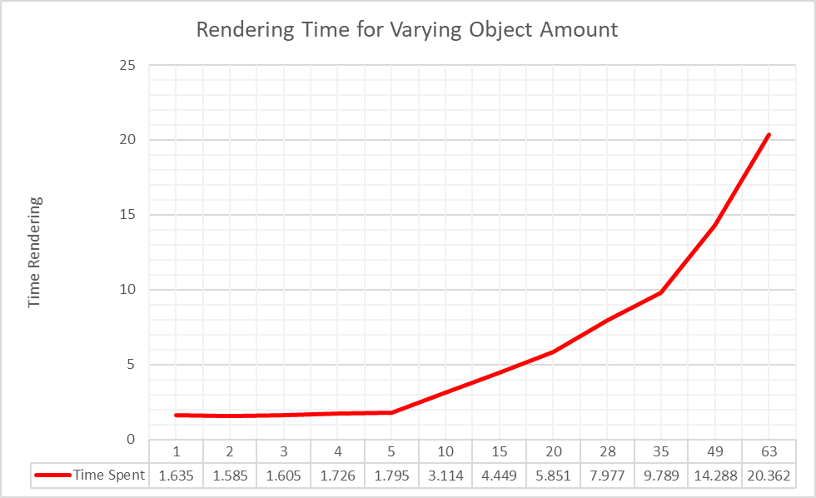
Experiments
How the render time is effected by the amount of objects in the scene.
The scene itself consists of small spheres and the screen is split into 6 parts as the what was the shortest time in the last experiment.
More objects that are in the scene the longer it takes to render. Though even with 63 objects it takes around 20 seconds.

Slide 15
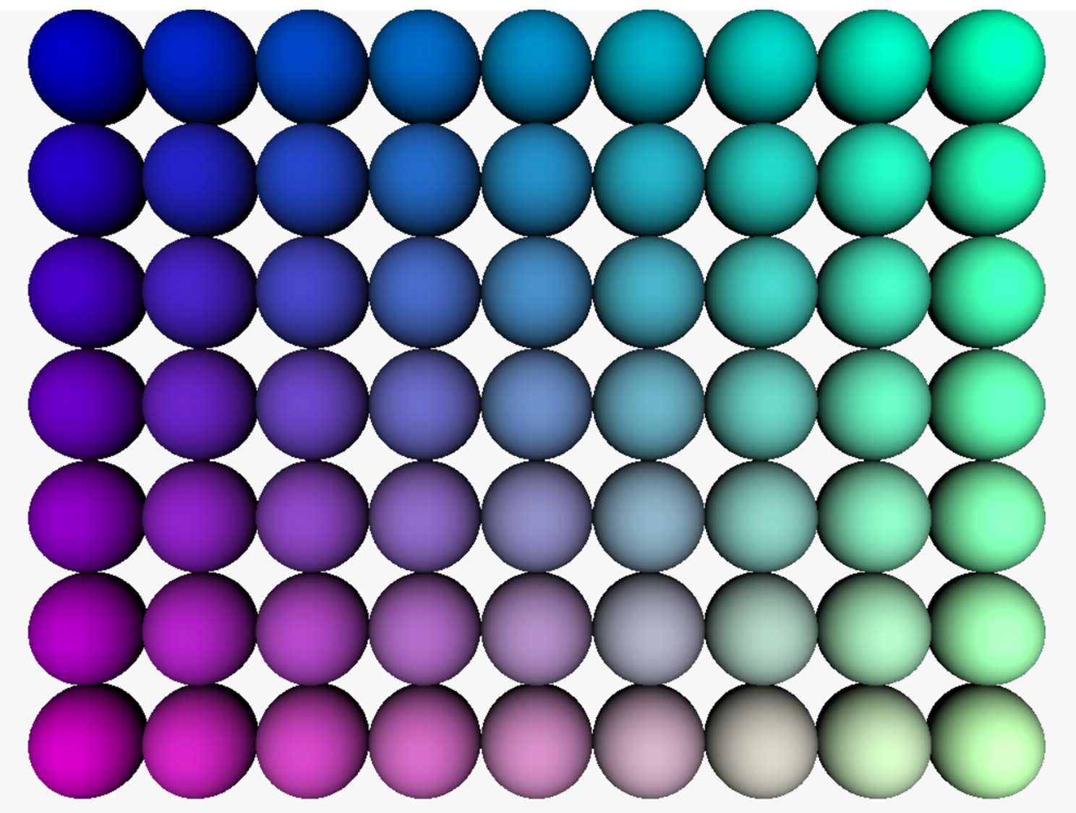
The Scene

Slide 16
Final Thoughts
Overall I feel the final project came out well, I was originally planning to add more features but I ran into some issues here and I ran out of time to implement and fix everything.
I also would have wished to look into some other parallel processes but I was too focused on the ray tracing aspects of this project. Though I am pleased with multi-threading I was able to implement. As it works well and speeds up the rendering time well
Overall I am pleased with how the project came out and I do hope to implement more the features I in the future.

Slide 17
References
Scratchapixel. (2020). Introduction to Shading. [online] Available at: https://www.scratchapixel.com/lessons/3d-basic-rendering/introduction-to-shading [Accessed 20 Dec. 2019].
Glassner, A. (1991). An Introduction to ray tracing. 1st ed. London: Academic Press.
Shirley, P. (2020). Ray Tracing in One Weekend. [online] Available at: https://raytracing.github.io/books/RayTracingInOneWeekend.html [Accessed 16 Dec. 2019].
Mahapatra, S. (2020). Multithreading in C++ - GeeksforGeeks. [online] GeeksforGeeks. Available at: https://www.geeksforgeeks.org/multithreading-in-cpp/ [Accessed 15 Dec. 2019].
Thread Pool Tutorial - How-To. (2018). [video] Directed by Code Blacksmith. https://www.youtube.com/watch?v=eWTGtp3HXiw.
Rademacher, P. (2020). Ray Tracing: Graphics for the Masses. [online] Wwwx.cs.unc.edu. Available at: http://wwwx.cs.unc.edu/~rademach/xroads-RT/RTarticle.html [Accessed 20 Dec. 2019].
Barney, B. and Livermore Computing (n.d.). Introduction to Parallel Computing. [online] Computing.llnl.gov. Available at: https://computing.llnl.gov/tutorials/parallel_comp/ [Accessed 19 Dec. 2019].

